Slide 1
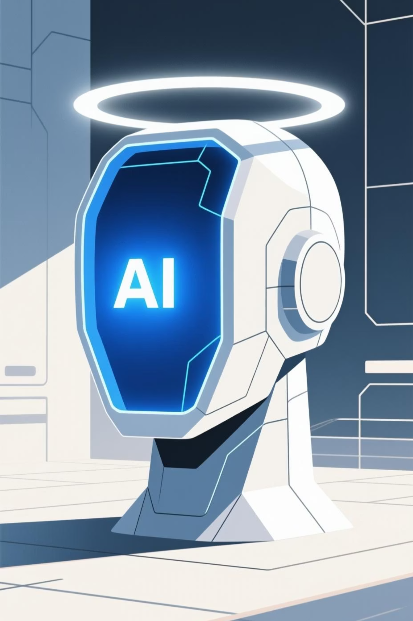



Understanding "State of the Art" in Artificial Intelligence
State of the art represents the pinnacle of what's achievable with today's technology—the cutting edge that pushes the boundaries of what machines can accomplish.
By
Bh Sai Ganesh
Asst. Professor
Aditya University

Slide 2





What Does "State of the Art" Actually
Mean?
The Definition
State of the art refers to the highest level of development achieved at a particular time in any field of technology, science, or methodology.
"State"
The current level or condition of development
It represents the best-performing solutions currently available, backed by rigorous testing and validation.
"Art"
The skill, technology, or methodological approach
Together, these terms describe the most advanced and effective techniques available at this precise moment in time.

Slide 3

Why State of the Art Matters in
AI Research
Establishing what constitutes state of the art isn't just about claiming superiority—it serves critical functions that drive the entire field of artificial intelligence forwards.
1
2
Measuring Progress
Enabling Comparisons
Provides clear benchmarks to track how far AI capabilities have advanced over time, helping researchers understand the pace and direction of innovation.
Allows new algorithms and approaches to be rigorously compared against established methods, ensuring only genuine improvements are recognised.
3
4
Identifying Best Practices
Guiding Future Research
Highlights the strongest, most reliable techniques for deployment in real-world applications where performance truly matters.
Reveals gaps and opportunities, directing researchers towards the most promising areas for breakthrough discoveries and development.

Slide 4




Pioneering Achievement: Stanley and
Autonomous Vehicles
DARPA Grand Challenge 2005
Stanford University's autonomous vehicle, Stanley, made history by completing the 132-mile desert course in under seven hours—the first vehicle to successfully finish the challenge.
Stanley represented a monumental leap in robotic navigation, combining advanced sensors, machine learning algorithms, and real-time decision-making capabilities to navigate unpredictable terrain without human intervention.
This achievement demonstrated that self-driving technology was no longer science fiction but an achievable engineering goal, paving the way for today's autonomous vehicle industry.
Legacy Impact: Stanley's success catalysed massive investment in autonomous driving research, directly influencing the development of modern self-driving systems at companies like Waymo, Tesla, and Cruise
.

Slide 5
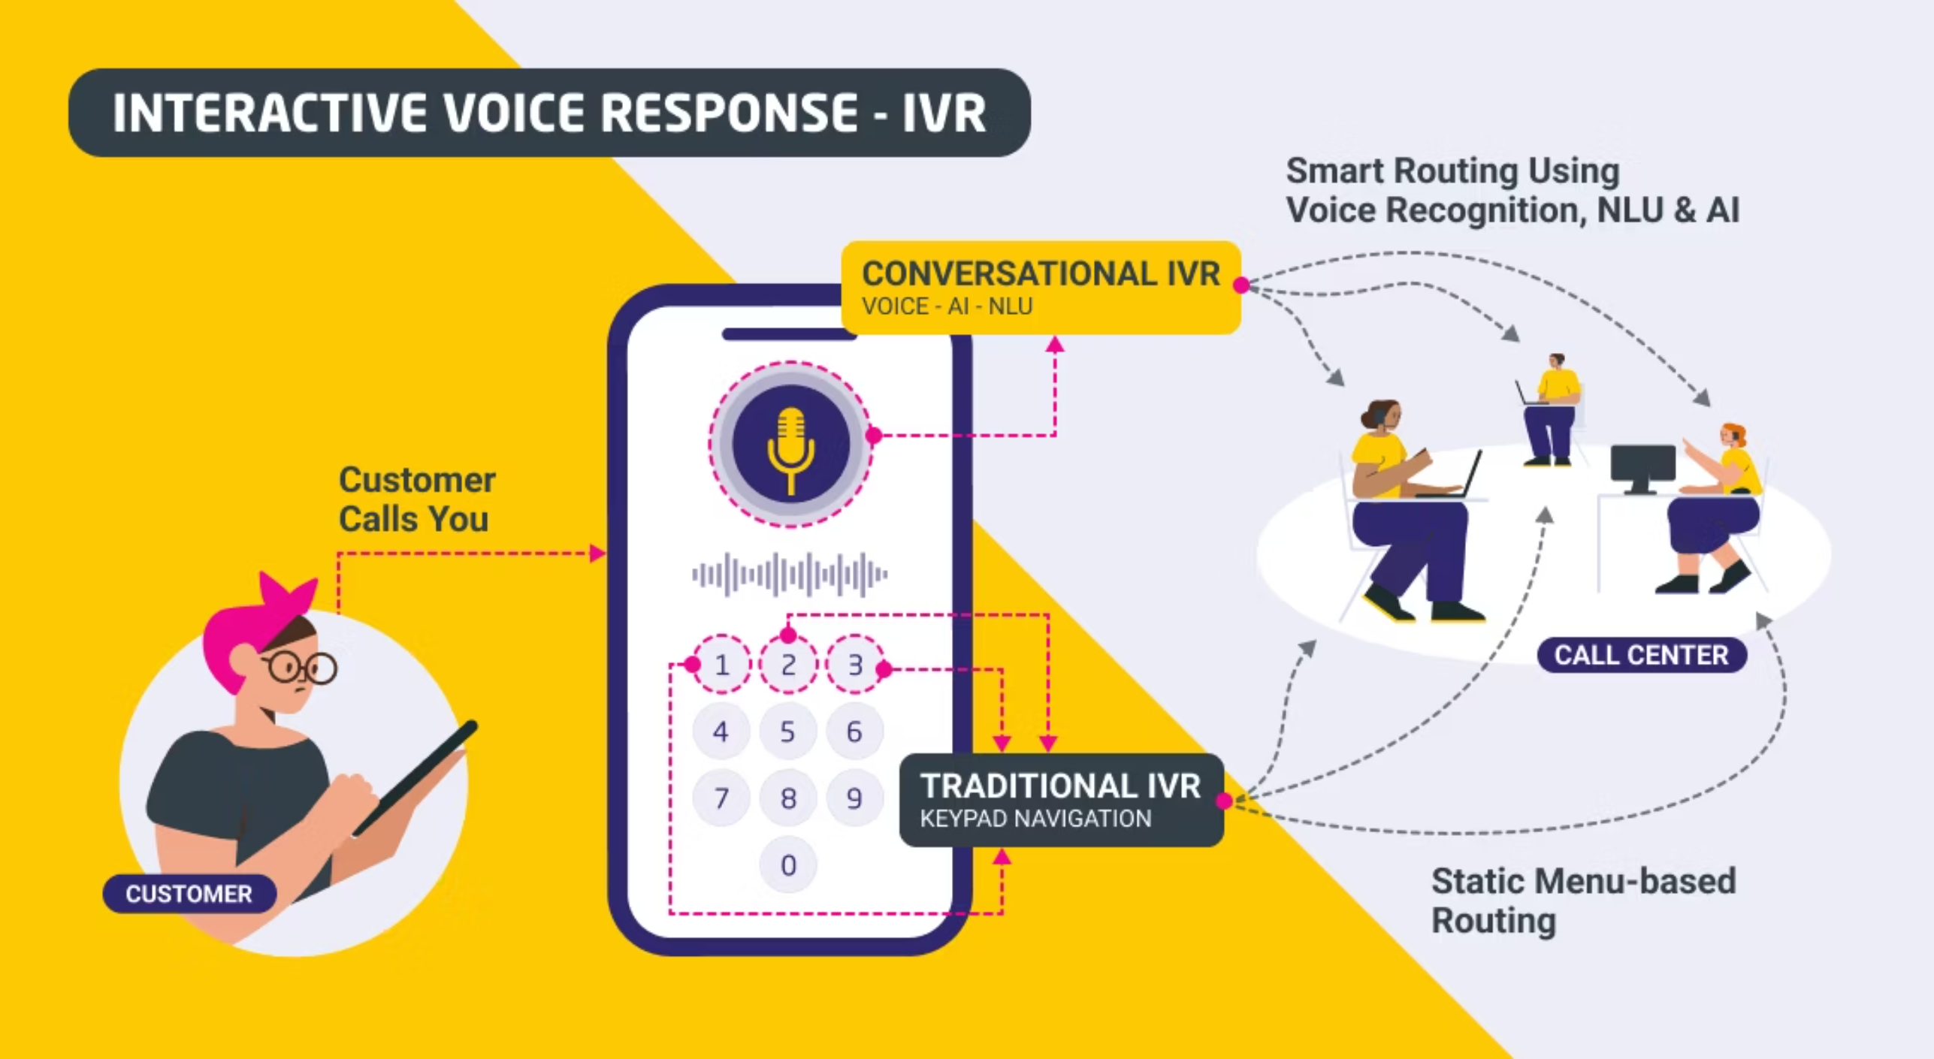


SPEECH RECOGNITION (Talking to a Computer):
“When you call an airline or bank, sometimes a computer talks to you.It listens to your
voice, converts speech into text, understands your request, and talks back.”

Slide 6


The Roomba Vacuum Cleaner
Robotics Meets Consumer Needs
The iRobot Roomba, launched in 2002, brought sophisticated robotics into millions of homes worldwide. It wasn't the most advanced robot ever built, but it solved a real problem with elegant simplicity.
Key Innovations
Adaptive navigation algorithms that map room layouts
Intelligent sensor integration for obstacle avoidance
Self-charging capabilities and autonomous operation
Affordable pricing that made robotics accessible
The Roomba demonstrated that state-of-the-art AI doesn't always mean the most complex system—sometimes it means the most practical and widely adopted solution.

Slide 7




Breaking Language Barriers: Neural Machine Translation
Machine translation has evolved from simple word-for-word replacement to sophisticated neural networks that understand context, idiom, and cultural nuance. Arabic-to-English translation systems exemplify this progress, tackling one of the most challenging language pairs.
Rule-Based Systems
Manual grammar rules, literal translations, poor fluency
Statistical Methods
Learning from parallel texts, improved accuracy, still rigid
Neural Networks
Context-aware, natural-sounding output, continuous learning
Today's neural machine translation systems achieve near-human quality for many language pairs, enabling real-time communication across linguistic boundaries and supporting global collaboration at unprecedented scale.

Slide 8





Multiple Domains, Unified Progress
Space Exploration
Strategic Game Playing
NASA Remote Agent (Deep Space 1): The first AI system to autonomously control a spacecraft, planning and scheduling operations millions of kilometres from Earth without human oversight.
IBM Deep Blue vs Kasparov: In 1997, Deep Blue's victory over world chess champion Garry Kasparov proved that AI could match and exceed human strategic thinking in complex domains.
Cybersecurity
Logistics Optimisation
Anti-Spam Systems: Machine learning revolutionised email filtering, detecting and blocking billions of spam messages whilst learning from evolving attacker strategies.
DART (Dynamic Analysis and Replanning Tool): Automated military logistics planning during the Gulf War, coordinating transportation and scheduling with unprecedented efficiency.

Slide 9


The Continuous Journey of Innovation
State of the Art Never Stands Still
Every breakthrough becomes tomorrow's baseline.
Each achievement in AI—from autonomous vehicles to natural language processing—builds upon previous innovations whilst opening new frontiers for exploration.
Understanding state of the art helps us appreciate how far we've come and illuminates the path forwards.
As students and professionals entering this field, you're not just learning about past achievements—you're preparing to define the next generation of breakthroughs.

Slide 10






What is an AI Agent?
In artificial intelligence, an 'agent' is anything that observes its environment through sensors and acts upon that environment through effectors. This core concept helps define how AI systems interact with and influence the world around them.
Human Agent
Animal Agent (e.g., Dog)
Perceives: Eyes (sight), Ears (sound)Acts: Hands (manipulation), Legs (movement)
Perceives: Nose (smell), Ears (sound)Acts: Legs (running), Mouth (biting)
Robotic Agent
Software Agent
Perceives: Camera (vision), Sensors (touch)Acts: Wheels (movement), Grippers (grasping)
Perceives: Keyboard input, Network dataActs: Display output, Database writes

